Slide 1
Mininet Tutorial
EL6363 Supplemental material for Lab 3

Slide 2
Lab3 Objectives
Introduction to Software Defined Network
Master the simulation tool: mininet
Understand the operation of Openflow and observe its messages
Interfacing with Open Virtual Switch
Implement a simple flow-based routing algorithm

Slide 3
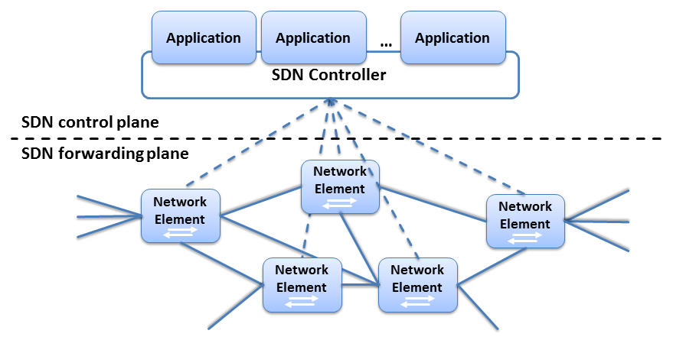
Software Defined Network (SDN)

Slide 4
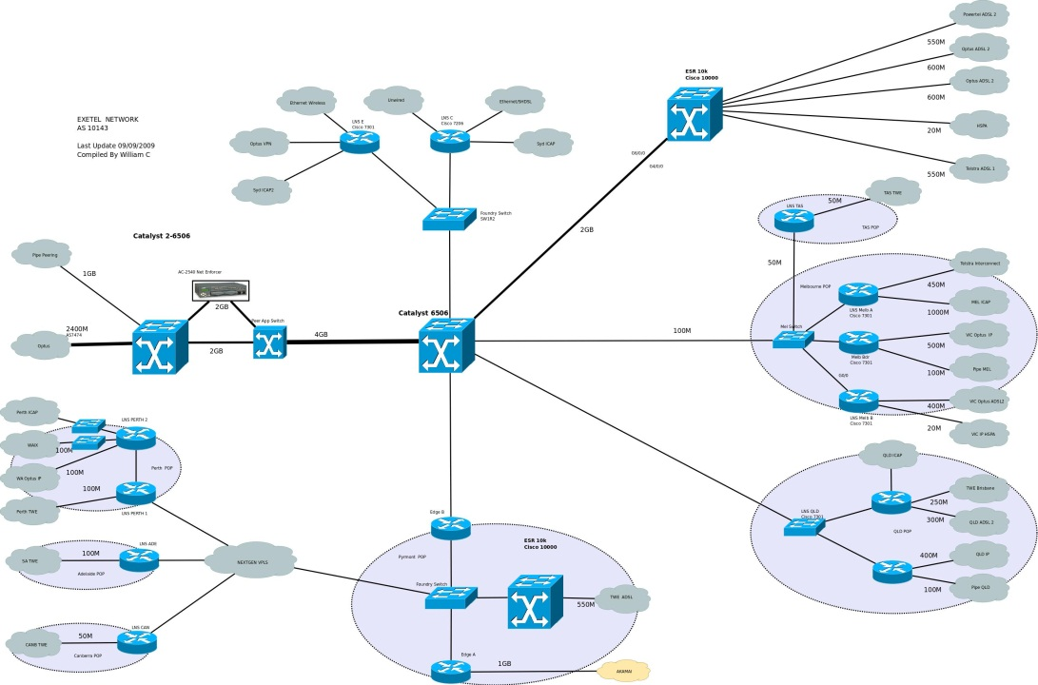
Mininet
MiniNet creates scalable Software-Defined Networks (up to hundreds of nodes) using OpenFlow, on a single PC
It allows to quickly create, interact with and customize a software defined network prototype with complex topologies, and can be used to emulate real networks – all on your PC
MiniNet can work with any kind of OpenFlow controller
It takes seconds to install it
Easy to program
Of course, it is an open source project

Slide 5
What does mininet provide?
Mininet emulates software defined networks.
Create virtual hosts and virtual switches
Test the connectivity and performance in a virtual environment
Mininet
Software Switch
Virtual Host
Virtual Host
Virtual Links

Slide 6
Lab3 Overview (part 1)
Simulate a software defined network with 2 hosts and 5 switches
1
OVS B
2
3
2
1
1
H1
1
3
3
4
H2
OVS A
OVS E
OVS D
3
2
2
3
1
OVS C
2

Slide 7
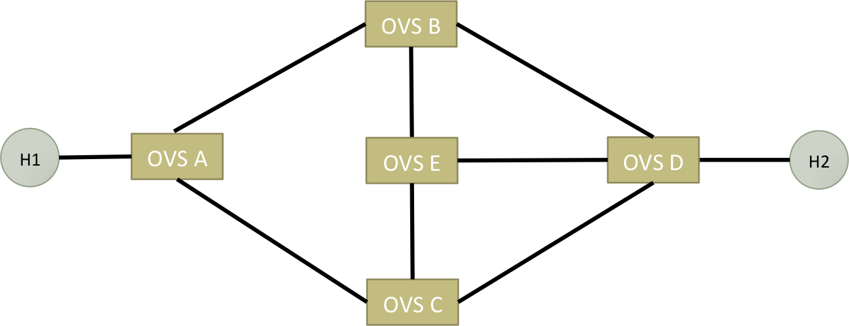
Lab3 Overview (part 1)
Implement flow-based routing instead of destination-based routing
Traffic from H1 ➔ H2
HTTP traffic with d_port=80, follow path: A-C-D
other traffic, follow path: A-B-E-D
Traffic from H2 ➔ H1
HTTP traffic with s_port=80, follow path: D-B-A
other traffic, follow path: D-C-E-B-A
Generate traffic and verify your result with Wireshark

Slide 8
Lab3 Overview (part 2)
Given switches with N ports, create a 2-stage fat-tree topology with hosts in Mininet
Make N an input parameter to your program (python script)
Ex:
sw
sw
sw
sw
sw
sw
sw
sw
sw
sw
sw
sw
sw
sw
sw
H
H
H
H
H
H
H
H
H
H
H
H
H
H
H
H
H
H
H
H
H
H
H
H
H
H
N=4
N=6

Slide 9
Lab3 Steps
Install and run mininet
Follow mininet walkthrough and learn its commands
Capture OpenFlow messages passed through mininet hosts
Create a customized topology
Install custom forwarding rules on switches

Slide 10
Installing mininet (Option 1) - recommended
Install a Ubuntu VM using either VMWare Player or VirtualBox
Install mininet through apt-get (remember to update first)
sudo apt-get update
sudo apt-get install mininet
Test installed mininet
sudo mn --test pingall
To install default ovs controller
sudo apt-get install openvswitch-testcontroller
sudo cp /usr/bin/ovs-testcontroller /usr/bin/ovs-controller

Slide 11
Installing mininet (Option 2)
Install a Ubuntu VM using either VMWare Player or VirtualBox
Follow the Option 2 instruction on http://mininet.org/download/
git clone git://github.com/mininet/mininet
mininet/util/install.sh [options]
sudo mn --test pingall

Slide 12
Installing mininet (Option 3)
Use a Linux VM Image that has mininet installed
Download the image from: http://mininet.org/vm-setup-notes/
Download and install VMWare Player or VirtualBox
VMWare: https://my.vmware.com/web/vmware/free#desktop_end_user_computing/vmware_player/6_0
VirtualBox: https://www.virtualbox.org/wiki/Downloads
Run the mininet VM using either program

Slide 13
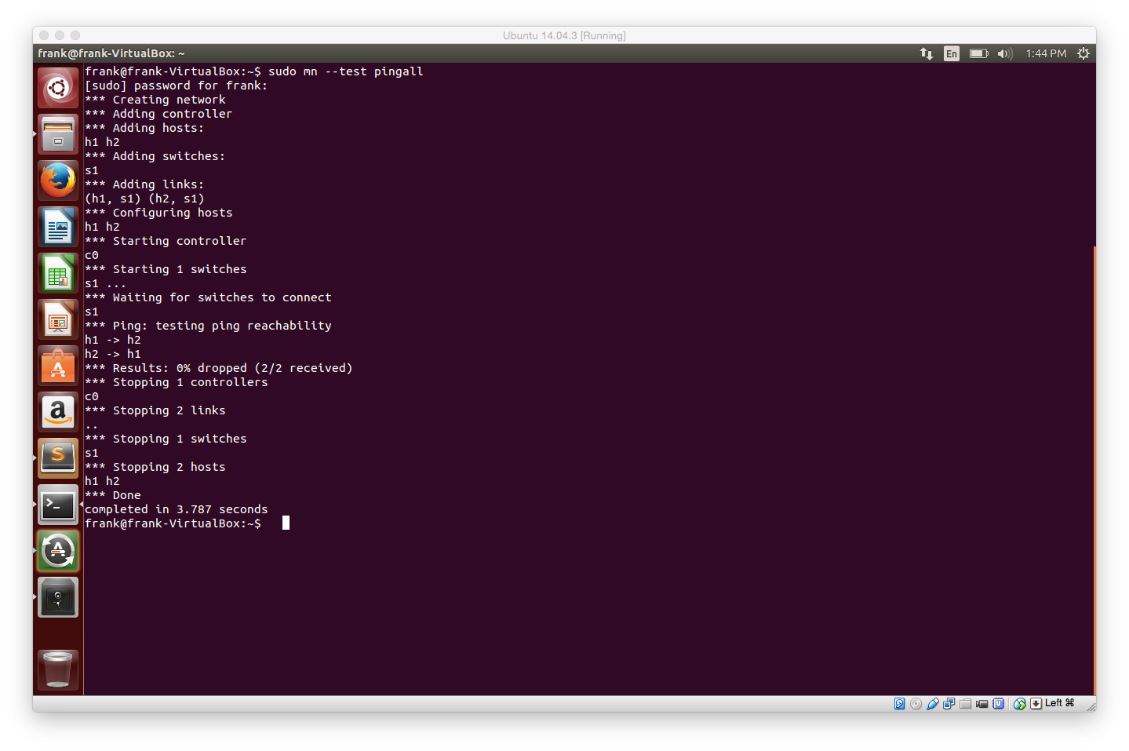
Running mininet
sudo mn --test pingall
Controller
H1
S1
H2

Slide 14
Mininet Walkthrough
Follow the official mininet walkthrough & introduction
http://mininet.org/walkthrough/
https://github.com/mininet/mininet/wiki/Introduction-to-Mininet
Learn
How to Run mininet, both
Within mininet prompt
With python scripts
mininet’s basic commands
Test connectivity between hosts

Slide 15
Creating a custom topology
# Add hosts and switches
H1 = self.addHost( ‘H1' )
H2 = self.addHost( ‘H2' )
S1 = self.addSwitch( ‘S1' )
S2 = self.addSwitch( ‘S2' )
# Add links
self.addLink( H1 , S1 )
self.addLink( S1, S2 )
self.addLink( S2, H2 ) Refer to: https://github.com/mininet/mininet/blob/master/custom/topo-2sw-2host.py
H1
S1
S2
H2

Slide 16
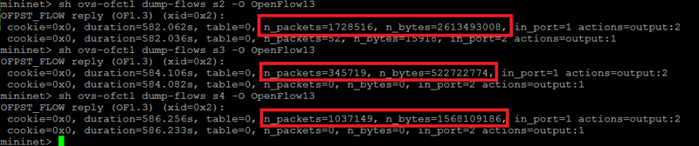
Manually installing rules on OVS nodes
In the lab we need these commands (you may need to sudo):
ovs-ofctl show s1
ovs-ofctl dump-flows s1
ovs-ofctl add-flow s1 in_port=1,actions=output:2
ovs-ofctl add-flow s1 priority=500,in_port=1,dl_type=0x0800,nw_proto=6,actions=output:2
Example:
For more details refer to: http://openvswitch.org/support/dist-docs/ovs-ofctl.8.txt http://www.pica8.com/document/v2.3/html/ovs-commands-reference/

Slide 17
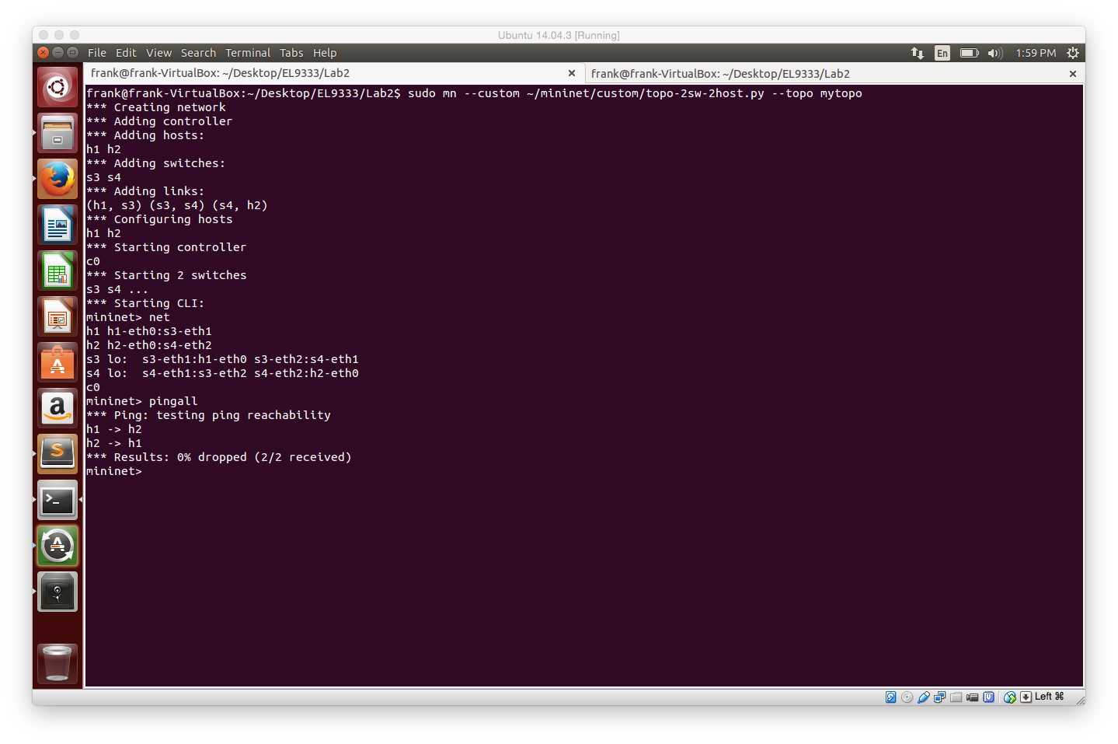
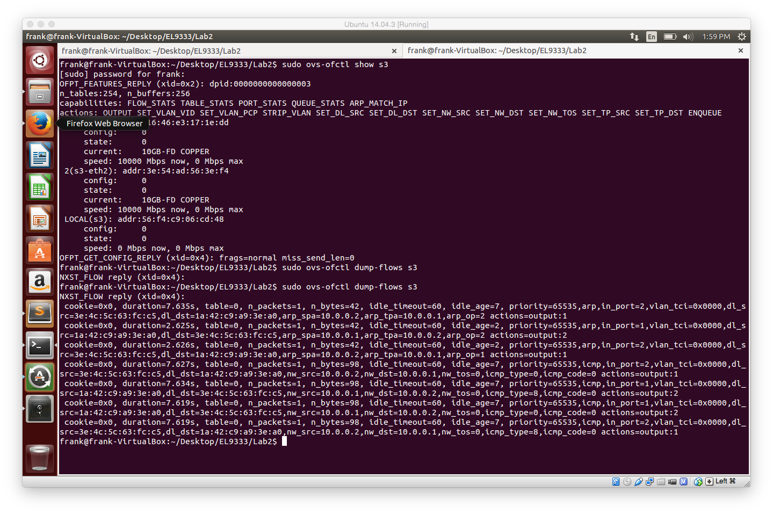
Running Mininet with Custom Topology
To launch Mininet with default controller:
sudo mn --custom ~/mininet/custom/topo-2sw-2host.py --topo mytopo
before pingall
after pingall

Slide 18
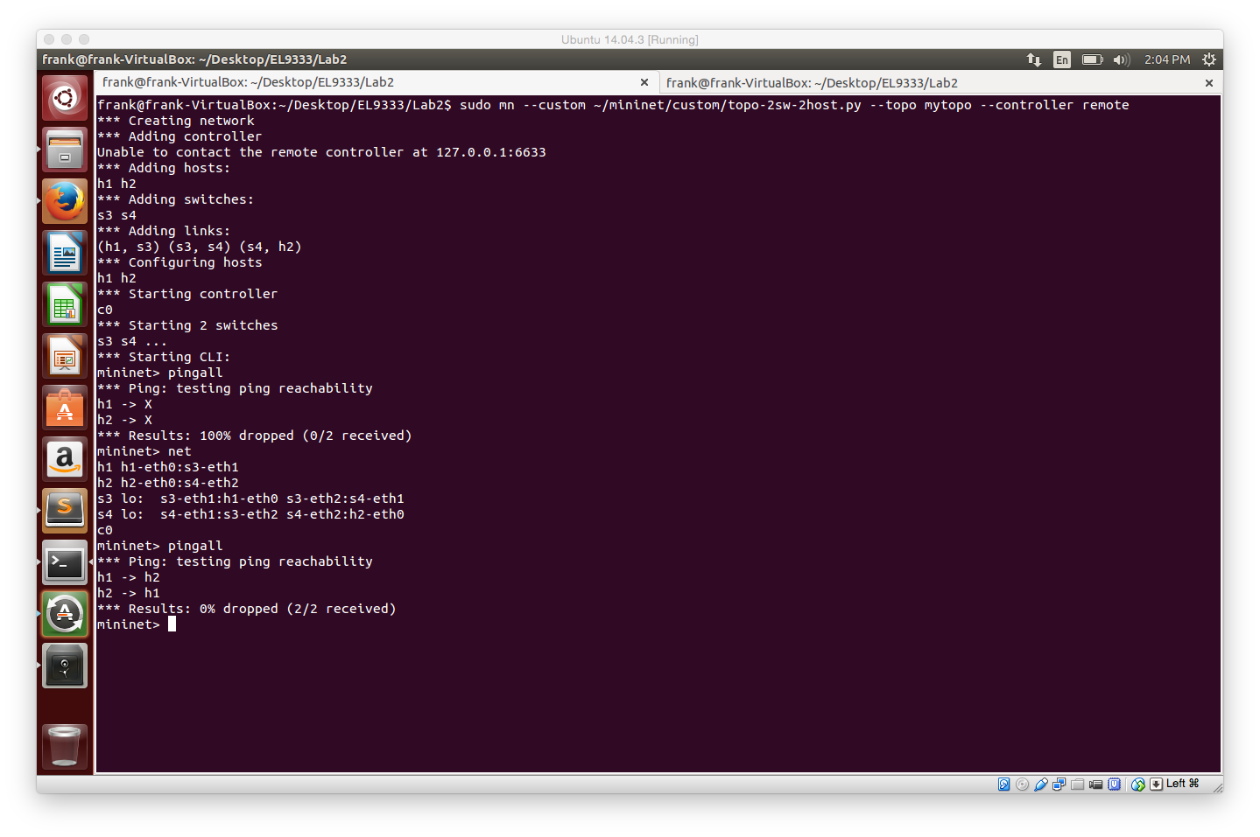
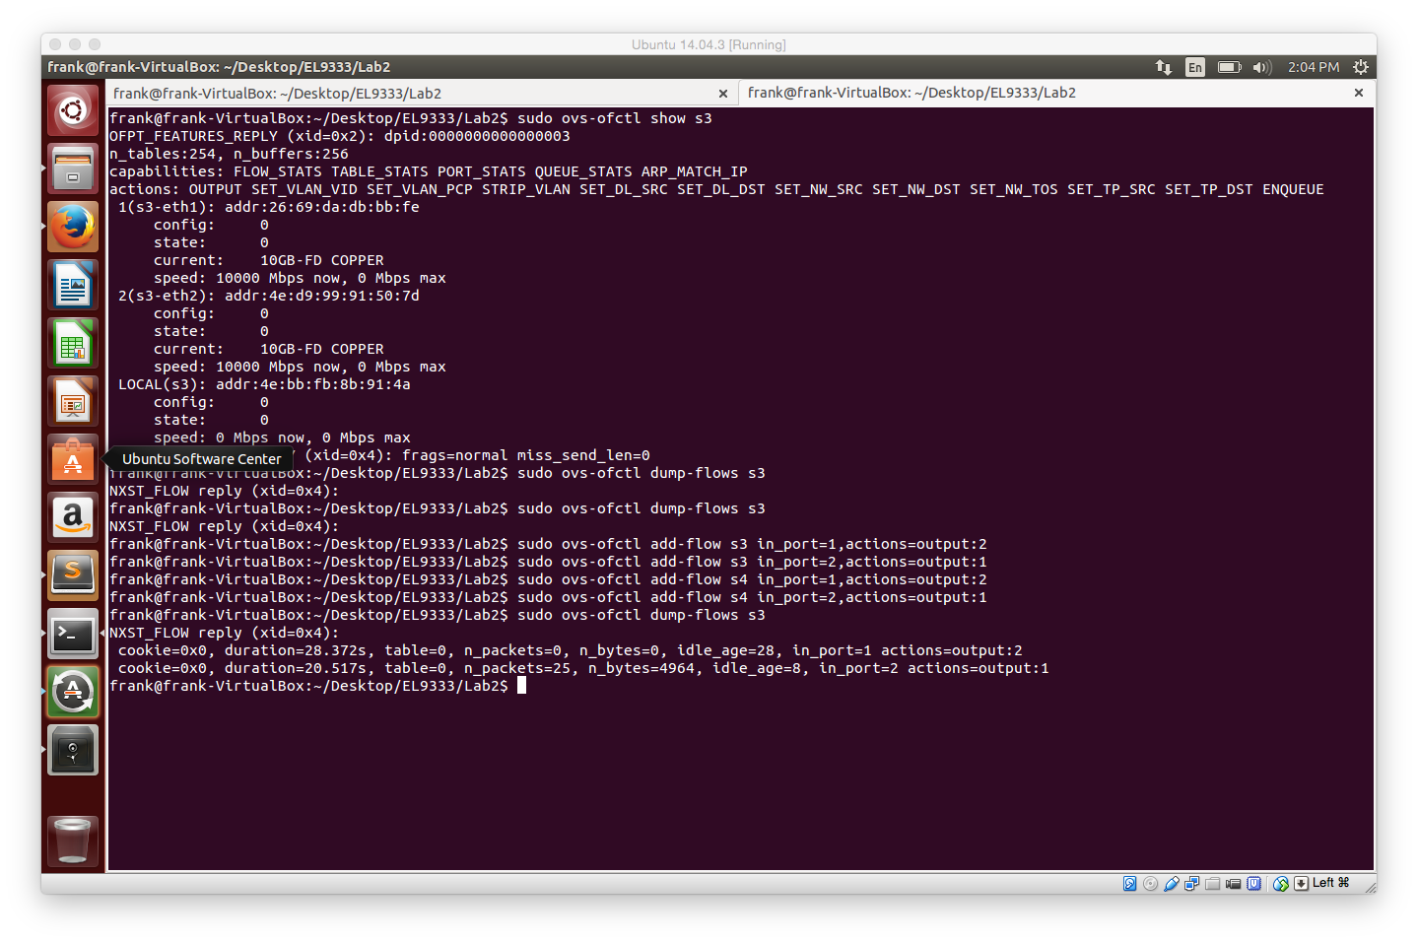
Running Mininet with Custom Topology
To launch Mininet without default controller:
sudo mn --custom ~/mininet/custom/topo-2sw-2host.py --topo mytopo --controller remote
before installing rules
installing rules
after installing rules

Slide 19
How to Run the Simulation
Use Mininet prompt
Ex: sudo mn --custom ~/mininet/custom/topo-2sw-2host.py --topo mytopo --controller remote
Giving parameter to mininet and enter a Mininet prompt
Put everything in a python script (Lab 3 Part 2)
Ex: python myScript.py
Putting everything in a python script, use python API to perform specific actions such as ping, iperf, ifconfig, etc …
For Lab 3 part 1, you can do it either way

